Slide 1
PROJECT TITLE
Contrast Enhancement-Based Forensics in Digital Images
49_Sreethu T Nair
S4 MCA B Batch

Slide 2
RELEVANCE OF THE TOPIC
The project aims with detecting whether the image has undergone any compression or if it is embedded with a file.
Forensic department mainly focuses on detecting any kind of malpractices done in the image, whereas the anti-forensic department tries to fool the forensic analyst by hiding the traces of compression.
In this project, anti-forensics method for digital image compression has been proposed.
JPEG is the most commonly used image standard.

Slide 3
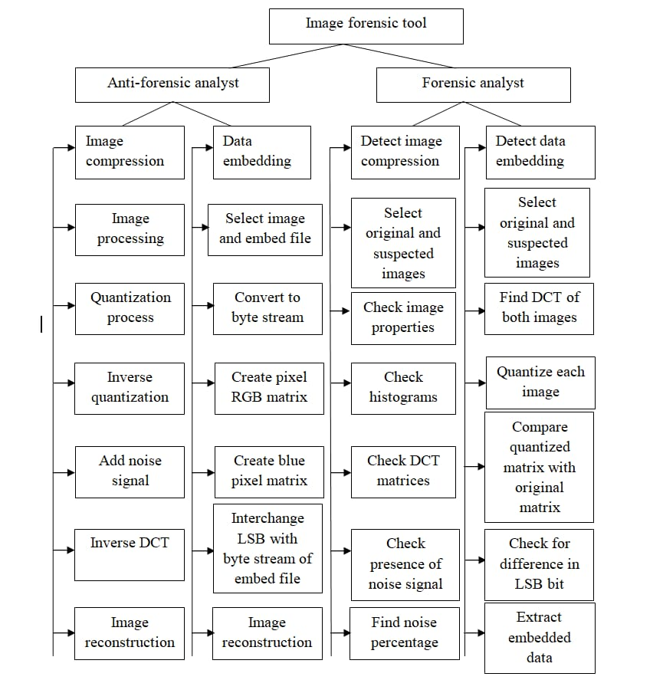
DESCRIPTION OF THE PROJECT

Slide 4
OBJECTIVES OF THE PROJECT
The availability of powerful graphic editing software, makes it easy to create image forgeries. As a result, a number of forensics methods have been developed for detecting digital image forgeries.
In order to improve the existing forensics method, anti-forensics methods have to be developed so that the loopholes in the existing forensics methods can be identified and hence forensics methods can be improved.
By doing so, researchers can be made aware of which forensics techniques are capable of being deceived, thus preventing altered images from being represented as authentic.
A large number of image forensics methods are available which are capable of identifying image tampering. But these techniques are not capable of addressing the anti-forensic method which is able to hide the trace of image tampering.
This anti-forensics method is capable of removing the traces of image compression.

Slide 5
MODULE DESCRIPTION
IMAGE PREPROCESSING
DCT HISTOGRAM GENERATION
QUANTIZATION MECHANISM
DEFECT DETECTION

Slide 6
ALGORITHM
Contrast enhancement pixel algorithm(DCT)
Discrete wavelet transform algorithm(DWT)

Slide 7
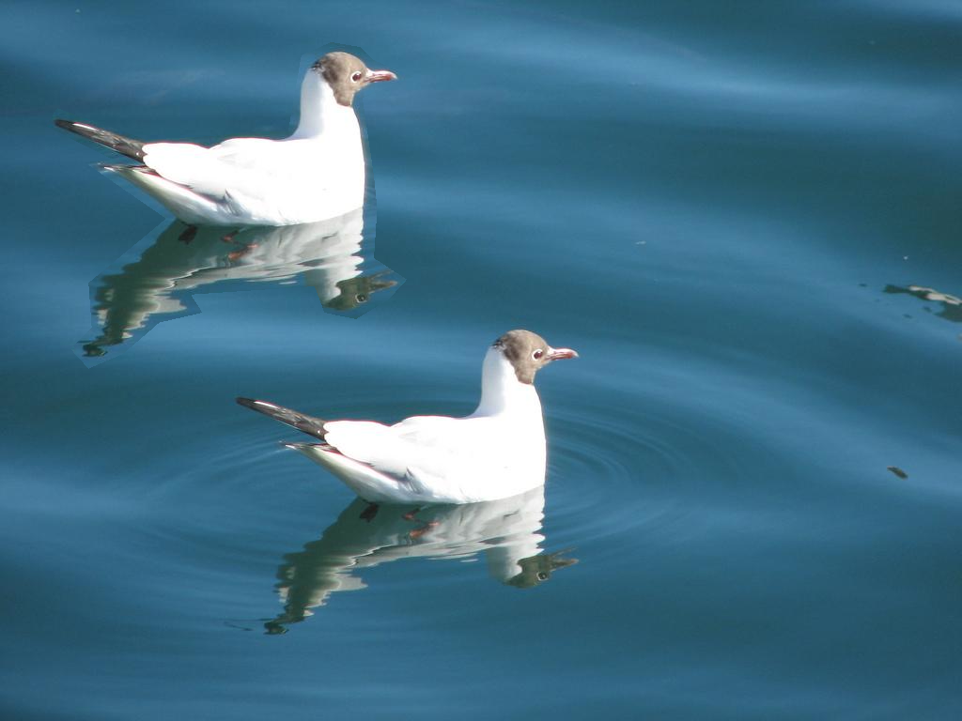
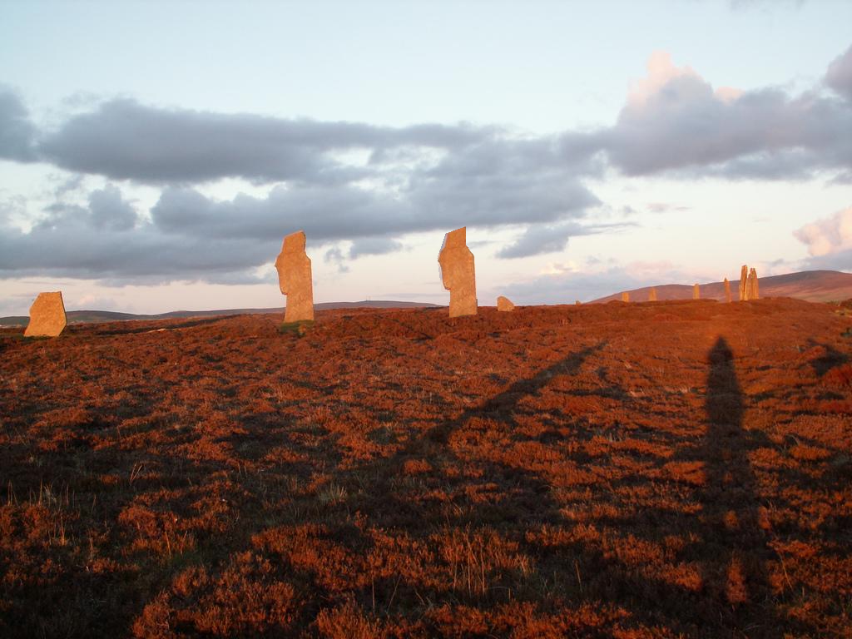
DATASET
The dataset have been collected from kaggle.com.

Slide 8
SCREENSHOTS

Slide 9

COMPRESSION

Slide 10


Slide 11
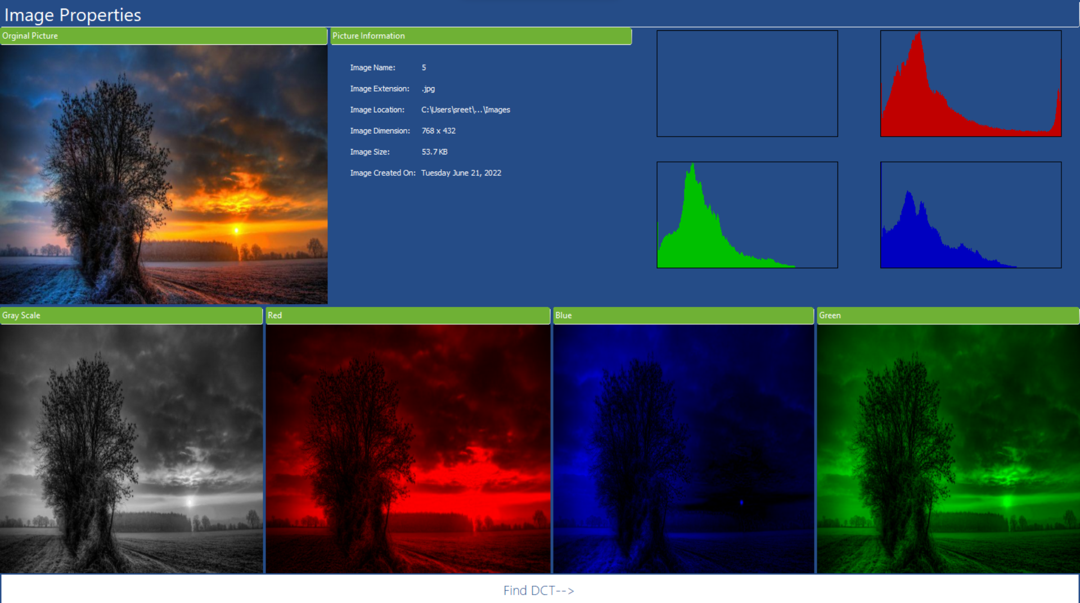

Slide 12
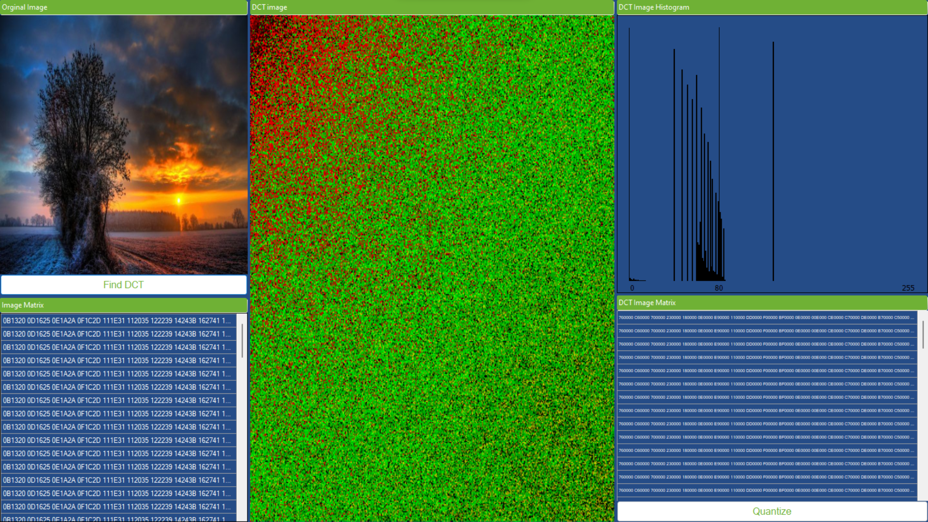

Slide 13
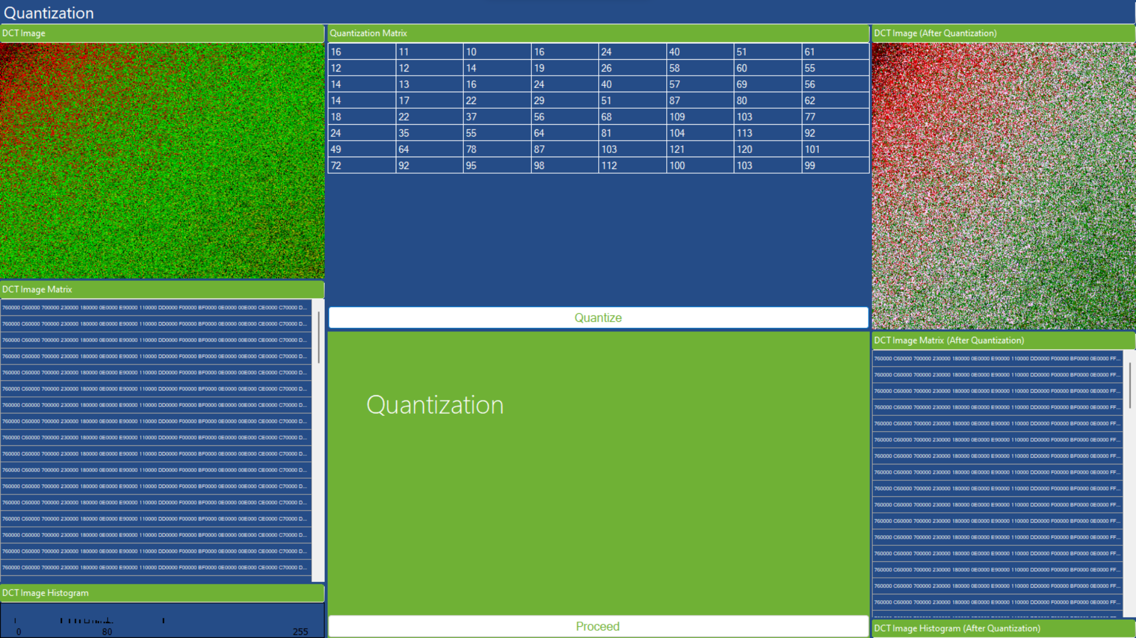

Slide 14
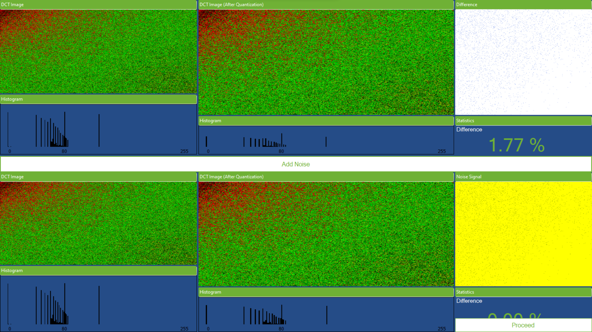

Slide 15
THANK YOU

